Slide 1


Slide 2




Readers Issues
Long Articles
Lack of Time
Multiple News Sources

Slide 3


Features of Singly News
Search News by Keyword
Readers will get
summarized
news rather than
a long article
Get audio format of
summarized news to
avoid time for reading
Save news
For future Reference
Collect latest news
from various resources
Share the exact content via
social media rather than links

Slide 4

Step by Step Process
News Bot Engine
Check Database For Similar News
Summarize News
Output
Audio
Text
Save
Share

Slide 5


Screenshots
Start Page

Slide 6
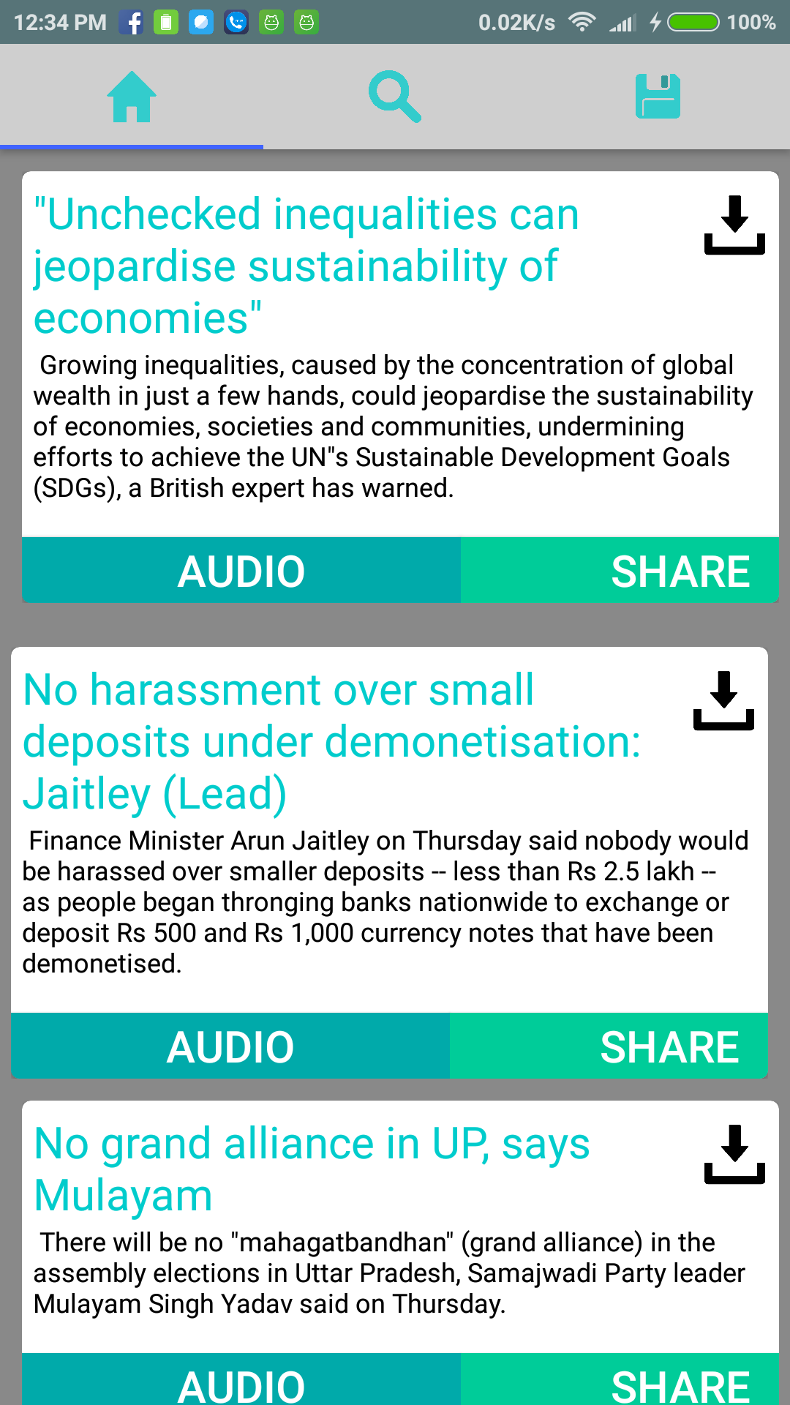
Screenshots
Home Page

Slide 7

Screenshots
Search

Slide 8
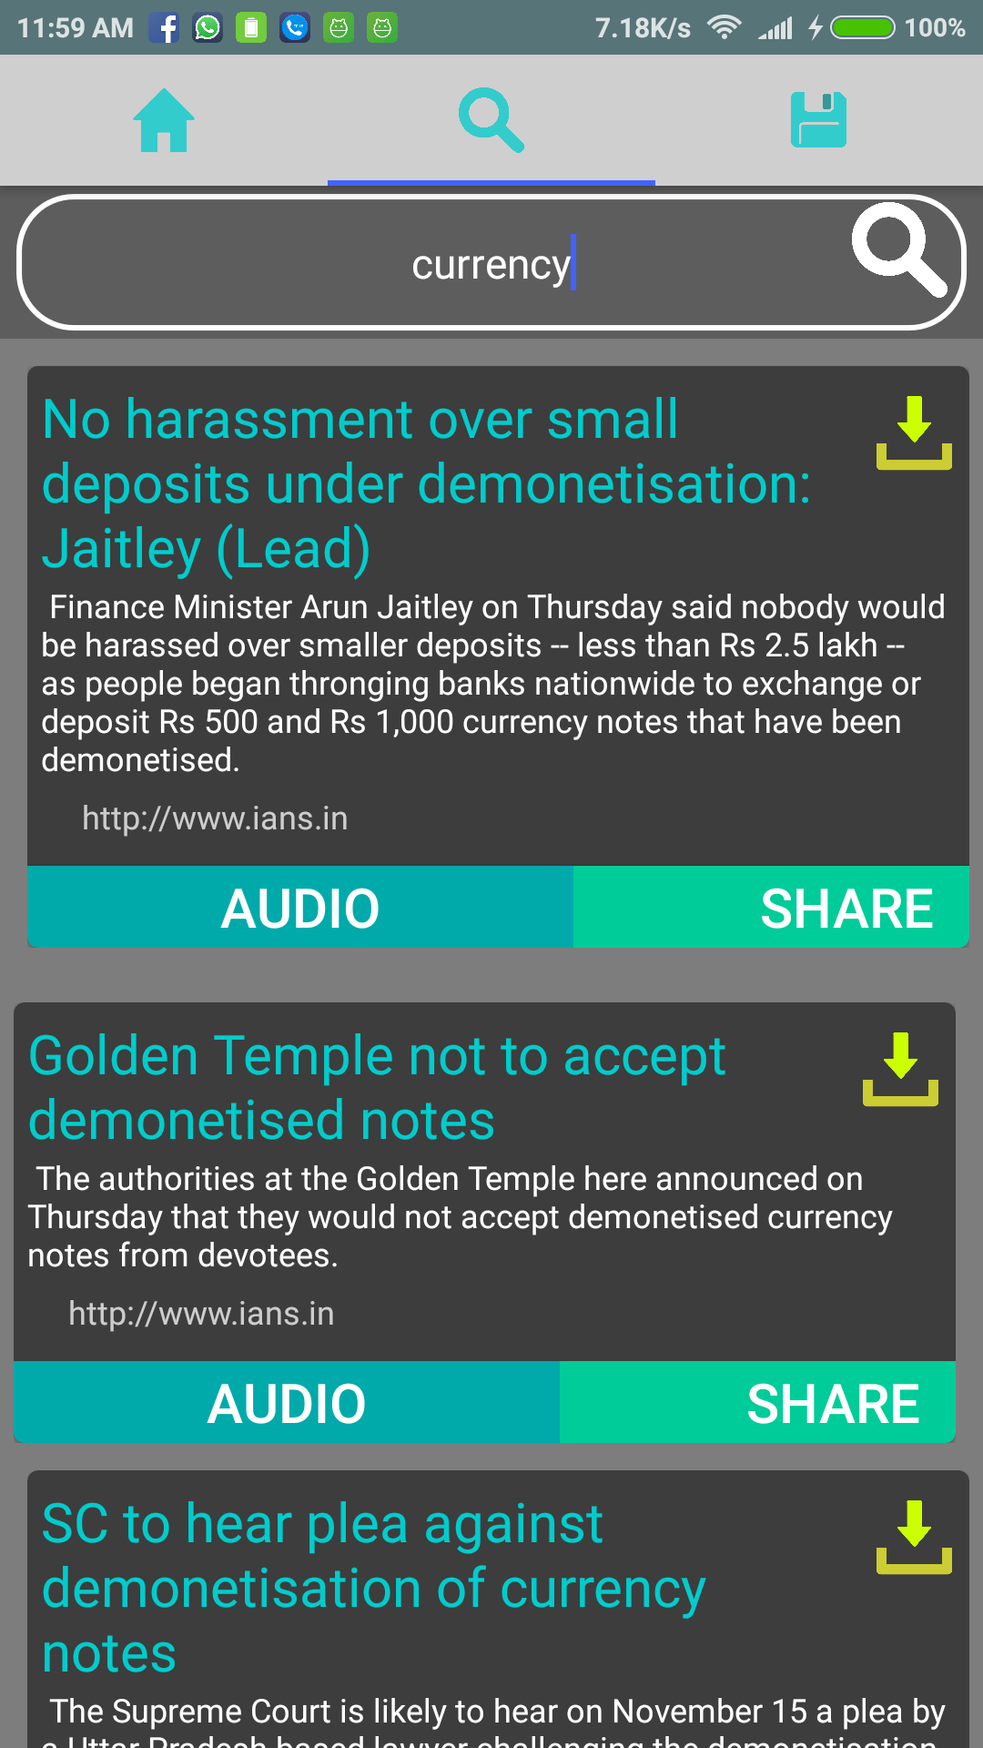
Screenshots
Search Result

Slide 9

Screenshots
Saved News

Slide 10

Screenshots
Share News

Slide 11


Irins Technologies

